Slide 1
Learning Management System

Slide 2
INDEX
Abstract
Objective of project
Problem Statement
Scope & Motivation
Introduction
Literature survey
Existing Method
Disadvantages
Proposed method
Advantages
Project Flow
Hardware and Software Requirements
Architecture
Modules
UML Diagram
References

Slide 3
ABSTRACT
In the digital era, the proliferation of online education and the need for effective learning platforms have highlighted the importance of Learning Management Systems (LMS). This abstract presents a comprehensive overview of the design and development of a cutting-edge Learning Management System aimed at facilitating educational institutions and organizations in delivering high-quality and engaging online learning experiences. The proposed Learning Management System integrates a range of key features and functionalities to enhance the learning process. These include course management, content delivery, assessment and grading, learner engagement, collaboration tools, and performance tracking. The system employs a user-friendly interface, providing intuitive navigation and accessibility across various devices to accommodate diverse learning styles and preferences. The architecture of the Learning Management System comprises three primary components: the front-end user interface, the backend database, and the administrative panel

Slide 4
ABSTRACT
The front-end interface is designed to provide a visually appealing and interactive learning environment, offering seamless access to course materials, multimedia content, discussion forums, and real-time communication channels. The backend database serves as the central repository for storing and organizing educational resources, user profiles, and learner progress data. It employs robust security measures to protect sensitive information and ensures smooth data management and retrieval processes. The administrative panel grants instructors and administrators comprehensive control over course creation, enrollment management, user analytics, and system configuration.
Keywords: Teacher, Student, Course, payment, etc

Slide 5
OBJECTIVE OF PROJECT
The objective of the project –Learning management system application is as follows:
The objectives of a Learning Management System (LMS) can vary based on the specific needs and goals of educational institutions or organizations. However, some common objectives of an LMS include. These objectives collectively aim to optimize the learning experience, improve learner outcomes, and facilitate effective administration and management of online education and training programs.

Slide 6
PROBLEM STATEMENT
Learning Management Systems. By developing innovative solutions that focus on standardization, learner engagement, comprehensive assessment, and inclusivity, LMS can truly empower educational institutions and organizations to deliver high-quality, personalized, and accessible online learning experiences that meet the needs of diverse learners in the digital age.

Slide 7
SCOPE AND MOTIVATION
Motivation:- The motivation for adopting an LMS revolves around improving the learning experience, increasing efficiency, fostering engagement and collaboration, and achieving better learning outcomes. An LMS empowers learners and instructors with the necessary tools and resources to facilitate effective teaching and learning in a digital era.
Scope:- The scope of a Learning Management System (LMS) encompasses various aspects related to online education and training. Here are the key dimensions that fall within the scope of an LMS. the scope of a Learning Management System encompasses the management, delivery, assessment, engagement, tracking, administration, integration, and accessibility aspects of online education and training.

Slide 8
INTRODUCTION
A learning management system (LMS) is a powerful tool designed to facilitate the management, delivery, and tracking of educational content and training programs. It serves as a comprehensive platform that enables educators, trainers, and administrators to create, organize, distribute, and monitor learning materials and activities in a centralized digital environment.
An LMS is commonly used in various educational settings, including schools, universities, corporate training programs, and online learning platforms. It streamlines the learning process by providing a virtual space where instructors can create and share engaging content, communicate with learners, assess their progress, and foster interactive learning experiences.

Slide 9
INTRODUCTION
The core functionalities of an LMS typically include:
Content Creation and Management: Users can create and upload a wide range of learning materials such as presentations, documents, videos, and quizzes. These resources can be organized into courses or modules for easy navigation.
Course Delivery: Learners can access the learning materials and activities at their own convenience, typically through a web-based interface or a mobile app. The LMS ensures that the content is available to the right users at the right time.
Communication and Collaboration: The LMS facilitates communication and collaboration between learners and instructors through discussion forums, messaging systems, and virtual classrooms. This promotes engagement, peer learning, and knowledge sharing.

Slide 10
LITERATURE SURVEY
S.NO | YEAR | AUTHORS | TITLE | OUT COMES
1 | 2015 | Katherine Li and Richard Lalancette | Learning management systems: An overview and comparative analysis | This paper provides an overview of LMS features, benefits, and challenges. It compares different LMS platforms and discusses their effectiveness in supporting teaching and learning
2 | 2014 | Abdul Rahman Ahlan | Evaluating learning management system success | This study presents a framework for evaluating the success of LMS implementation in higher education. It identifies key success factors and proposes a measurement model to assess LMS effectiveness.

Slide 11
LITERATURE SURVEY
S.NO | YEAR | AUTHORS | TITLE | OUT COMES
3 | 2019 | Sahan Bulathwela | A systematic review of the literature on learning management system adoption | This review explores the barriers and enablers of LMS adoption in educational institutions. It identifies factors such as technical, organizational, and pedagogical aspects that influence successful implementation.
4 | 2017 | Muhammad Awais Bin Asghar | Exploring students' acceptance of learning management systems | This study investigates students' acceptance of an LMS and identifies factors influencing their intention to use the system. It highlights the importance of usability, perceived usefulness, and ease of use in determining LMS acceptance.

Slide 12
LITERATURE SURVEY
S.NO | YEAR | AUTHORS | TITLE | OUT COMES
5 | 2018 | Rafael del Valle | A review of the literature on learning management system implementation | This review synthesizes existing literature on LMS implementation in higher education. It discusses the benefits, challenges, and critical success factors of LMS adoption, and provides recommendations for effective implementation.
6 | 2020 | Shafika Isa | A literature review on the effectiveness of learning management systems in higher education | This literature review examines the effectiveness of LMS in supporting teaching and learning in higher education. It explores the impact of LMS on student outcomes, engagement, and satisfaction.

Slide 13
EXISTING SYSTEM
Previously the learning management used to take physically. The process is as follows o Approaching libraries and study halls .Whenever student need to learn some courses , student should either buy some books or visit any central libraries. Here it will take time and manual process should be required.

Slide 14
DISADVANTAGES
o It is time consuming.
o It needs lot of human effort.
o More time for accessing.
o Possibility of proxies.
o Possibility for human errors.

Slide 15
PROPOSED METHOD
The proposed system is a Learning management system designed to streamline and automate the process of bus course requests and getting courses. It aims to provide a user-friendly platform for student to buy courses online and operators to efficiently manage their providing online courses operations. The system will offer a range of features to enhance the buying courses for students .

Slide 16
ADVANTAGES
o Easy interface for the administrator to work on.
o Easy access to students.
o Generating reports instantly.
o Less time consuming process.
o Less human errors and proxies.

Slide 17
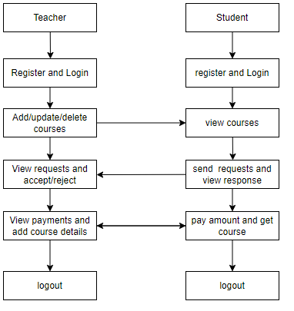
PROJECT FLLOW
Figure: work Flow of Proposed system

Slide 18
HARDWARE & SOFTWARE REQUIREMENTS
SOFTWARE REQUIREMENS
Operating System : Windows 7/8/10
Server side Script : React js
Programming Language : ASP .NET
IDE/Workbench :Visual Studio

Slide 19
HARDWARE & SOFTWARE REQUIREMENTS
SOFTWARE REQUIREMENS
Server Deployment : MS Server
Database : MSSql

Slide 20
HARDWARE & SOFTWARE REQUIREMENTS
HARDWARE REQUIREMENTS
Processor - I3/Intel Processor
RAM - 4GB (min)
Hard Disk - 128 GB
Key Board - Standard Windows Keyboard
Mouse - Two or Three Button Mouse
Monitor - Any

Slide 21
FUNCTIONAL AND NON-FUNCTIONAL REQUIREMENTS
Requirement’s analysis is very critical process that enables the success of a system or software project to be assessed. Requirements are generally split into two types: Functional and non-functional requirements.
Functional Requirements: These are the requirements that the end user specifically demands as basic facilities that the system should offer. All these functionalities need to be necessarily incorporated into the system as a part of the contract. These are represented or stated in the form of input to be given to the system, the operation performed and the output expected. They are basically the requirements stated by the user which one can see directly in the final product, unlike the non-functional requirements.

Slide 22
FUNCTIONAL AND NON-FUNCTIONAL REQUIREMENTS
Examples of functional requirements:
Authentication of user whenever he/she logs into the system
System shutdown in case of a cyber-attack
A verification email is sent to user whenever he/she register for the first time on some software system.
Non-functional requirements: These are basically the quality constraints that the system must satisfy according to the project contract. The priority or extent to which these factors are implemented varies from one project to other. They are also called non-behavioral requirements.

Slide 23
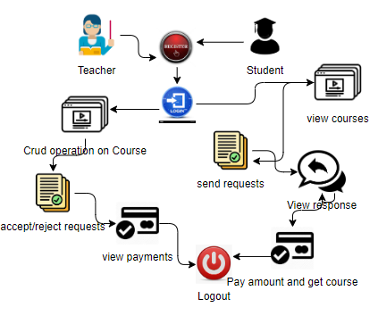
ARCHITECTURE

Slide 24
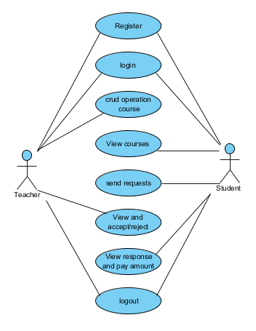
UML DIAGRAMS
Figure: Use Case Diagram

Slide 25
UML DIAGRAMS
Class Diagram:
In software engineering, a class diagram in the Unified Modelling Language (UML) is a type of static structure diagram that describes the structure of a system by showing the system's classes, their attributes, operations (or methods), and the relationships among the classes. It explains which class contains information.

Slide 26
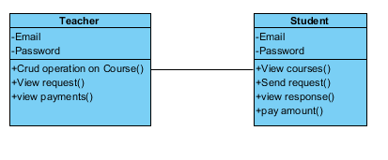
UML DIAGRAMS
Figure: Class diagram

Slide 27
UML DIAGRAMS
Sequence Diagram:
A sequence diagram in Unified Modelling Language (UML) is a kind of interaction diagram that shows how processes operate with one another and in what order. It is a construct of a Message Sequence Chart. Sequence diagrams are sometimes called event diagrams, event scenarios, and timing diagrams.

Slide 28
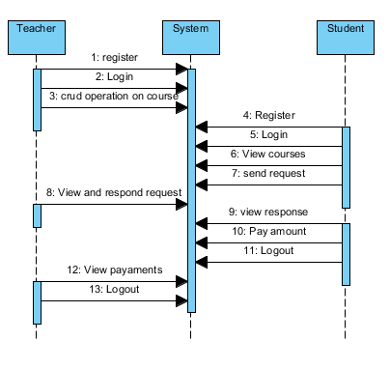
UML DIAGRAMS
Figure: Sequence diagram

Slide 29
UML DIAGRAMS
Collaboration Diagram:
In collaboration diagram the method call sequence is indicated by some numbering technique as shown below. The number indicates how the methods are called one after another. We have taken the same order management system to describe the collaboration diagram. The method calls are similar to that of a sequence diagram. But the difference is that the sequence diagram does not describe the object organization whereas the collaboration diagram shows the object organization.

Slide 30
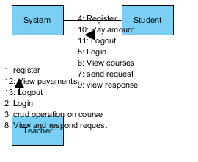
UML DIAGRAMS
Figure: Collaboration diagram

Slide 31
UML DIAGRAMS
Deployment Diagram
Deployment diagram represents the deployment view of a system. It is related to the component diagram. Because the components are deployed using the deployment diagrams. A deployment diagram consists of nodes. Nodes are nothing but physical hardware’s used to deploy the application.

Slide 32
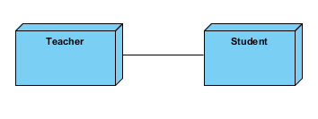
UML DIAGRAMS
Figure: Deployment diagram

Slide 33
UML DIAGRAMS
Activity Diagram:
Activity diagrams are graphical representations of workflows of stepwise activities and actions with support for choice, iteration and concurrency. In the Unified Modelling Language, activity diagrams can be used to describe the business and operational step-by-step workflows of components in a system. An activity diagram shows the overall flow of control.

Slide 34
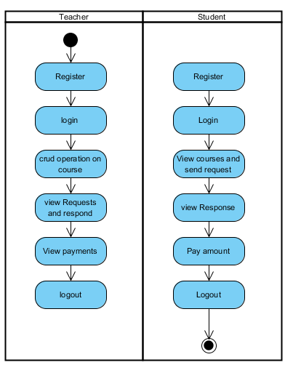
UML DIAGRAMS
Figure: Activity diagram

Slide 35
UML DIAGRAMS
Component Diagram:
A component diagram, also known as a UML component diagram, describes the organization and wiring of the physical components in a system. Component diagrams are often drawn to help model implementation details and double-check that every aspect of the system's required functions is covered by planned development.

Slide 36
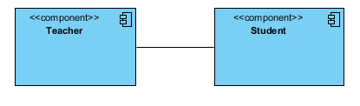
UML DIAGRAMS
Figure: Component diagram

Slide 37
UML DIAGRAMS
ER Diagram:
An Entity–relationship model (ER model) describes the structure of a database with the help of a diagram, which is known as Entity Relationship Diagram (ER Diagram). An ER model is a design or blueprint of a database that can later be implemented as a database. The main components of E-R model are: entity set and relationship set.
An ER diagram shows the relationship among entity sets. An entity set is a group of similar entities and these entities can have attributes. In terms of DBMS, an entity is a table or attribute of a table in database, so by showing relationship among tables and their attributes, ER diagram shows the complete logical structure of a database. Let’s have a look at a simple ER diagram to understand this concept.

Slide 38
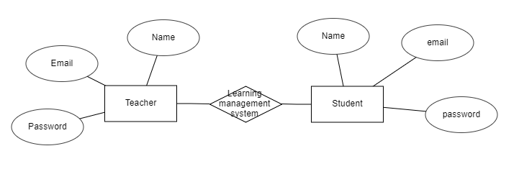
UML DIAGRAMS
Figure: ER diagram

Slide 39
UML DIAGRAMS
DFD Diagram:
A Data Flow Diagram (DFD) is a traditional way to visualize the information flows within a system. A neat and clear DFD can depict a good amount of the system requirements graphically. It can be manual, automated, or a combination of both. It shows how information enters and leaves the system, what changes the information and where information is stored. The purpose of a DFD is to show the scope and boundaries of a system as a whole. It may be used as a communications tool between a systems analyst and any person who plays a part in the system that acts as the starting point for redesigning a system.

Slide 40
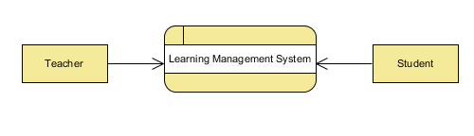
UML DIAGRAMS
Figure: Context Level diagram

Slide 41
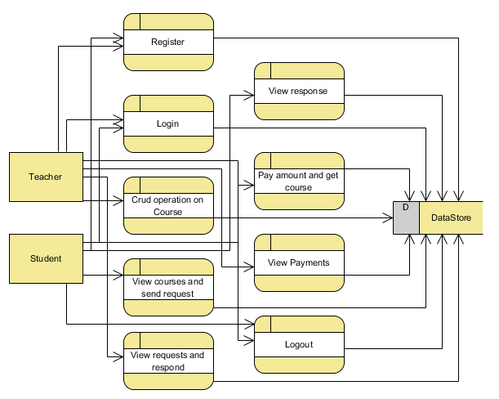
UML DIAGRAMS
FigureLevel-1 diagram

Slide 42
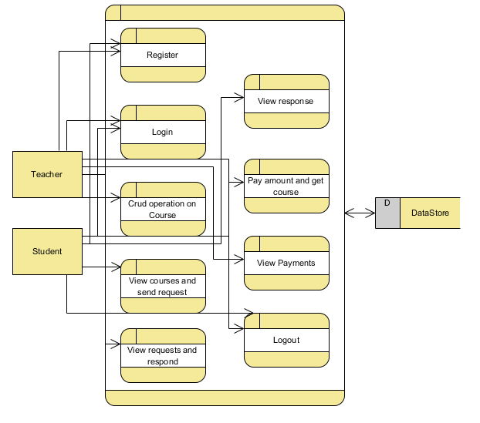
UML DIAGRAMS
Figure:Level-2 diagram

Slide 43
CONCLUSION
In conclusion, a well-implemented and well-utilized learning management system can revolutionize the way education is delivered and accessed. By leveraging the capabilities of an LMS, educational institutions, businesses, and individuals can enhance learning outcomes, improve efficiency, and adapt to the evolving needs of learners in the digital age.

Slide 44
FUTURE ENHANCEMENT
In the future, learning management systems (LMS) have the potential to undergo several enhancements and advancements to further improve the learning experience. Here are some possible future enhancements for LMS:
Artificial Intelligence (AI) Integration: AI can play a significant role in the LMS by personalizing learning paths based on individual learner's needs, preferences, and performance. AI algorithms can analyze data to provide adaptive learning recommendations, automated feedback, and intelligent tutoring.
Gamification Elements: Adding gamification elements such as badges, leaderboards, and rewards can enhance learner engagement and motivation. Gamified LMS interfaces can make the learning experience more interactive, enjoyable, and competitive.

Slide 45
REFERENCES
[1] Wen-xin, Li, and G. U. O. Wei. "Peking University Oneline Judge and Its Applications [J]." Journal of Changchun Post and Telecommunication Institute S 2 (2005).
[2] Kurnia, Andy, Andrew Lim, and Brenda Cheang. "Online judge." Computers & Education 36.4 (2001): 299-315.
[3] Cheang, Brenda, et al. "On automated grading of programming assignments in an academic institution." Computers & Education 41.2 (2003): 121-131.
[4] Kosowski, Adrian, Michał Małafiejski, and Tomasz Noiński. "Application of an online judge & contester system in academic tuition." Advances in Web Based Learning–ICWL 2007. Springer Berlin Heidelberg, 2008. 343-354.

Slide 46
REFERENCES
[5] Lee, James B., and Brent Ware. Open Source Web Development with LAMP: Using Linux, Apache, MySQL, Perl, and PHP. Addison-Wesley Professional, 2003.
[6] Griffith, Arthur. GCC: the complete reference. McGraw-Hill, Inc., 2002.
[7] Bray, Tim, et al. "Extensible markup language (XML)." World Wide Web Journal 2.4 (1997): 27-66.
[8] "Learning management systems: An overview and comparative analysis" by Katherine Li and Richard Lalancette (2015)

